Slide 1
An AI Review
- collaborative workshop
CAS ADS M5
University of Bern

Slide 2
Group 1 - Chapter 1 and 2 (Salomé, Hazel, Lenja, Daniëlle)
Group 2 - Chapter 3, 4, and 5 (Nicolas, Galina, Moataz, Tobias, Mayra)
Group 3 - Chapter 6 and 7 Marina
Group 4 - Chapter 8 and 9 (the ones onsite)
Each group creates max 20 slides and has 20 min for presentation and 20 minutes for discussion.
Notes:
Vorstellung Sukanya und Sigve, Umfrage

Slide 3
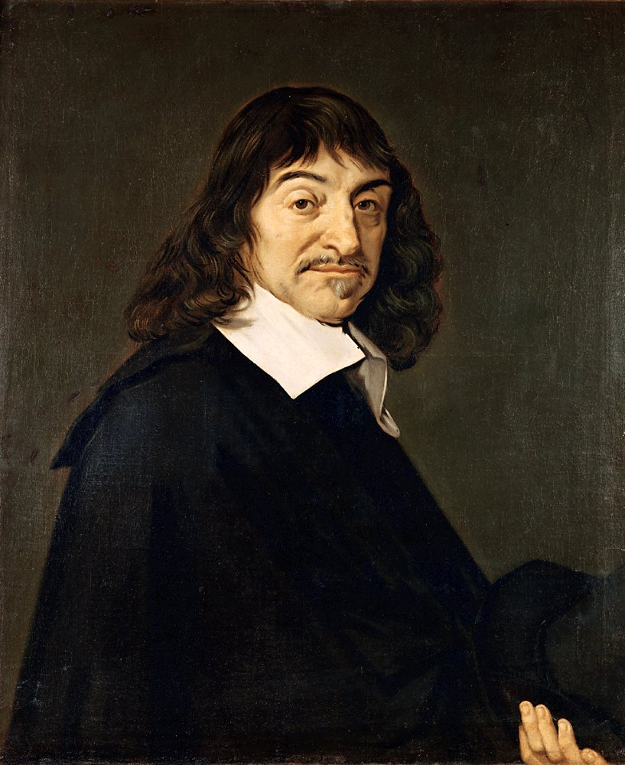
The History of AI - René Descartes 1637
Two certain tests to distinguish a machine from humans:
Speech: Machines can produce words or react to stimuli but cannot use language flexibly or meaningfully
Reasoning and Adaptability: Machines may perform specific tasks well but lack the universal reasoning and adaptability of humans
Conclusion: Human reason allows us to act and react appropriately across a range of situations whereas computers are always limited to the pre-programmed responses

Slide 4
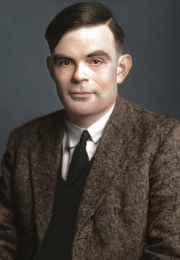
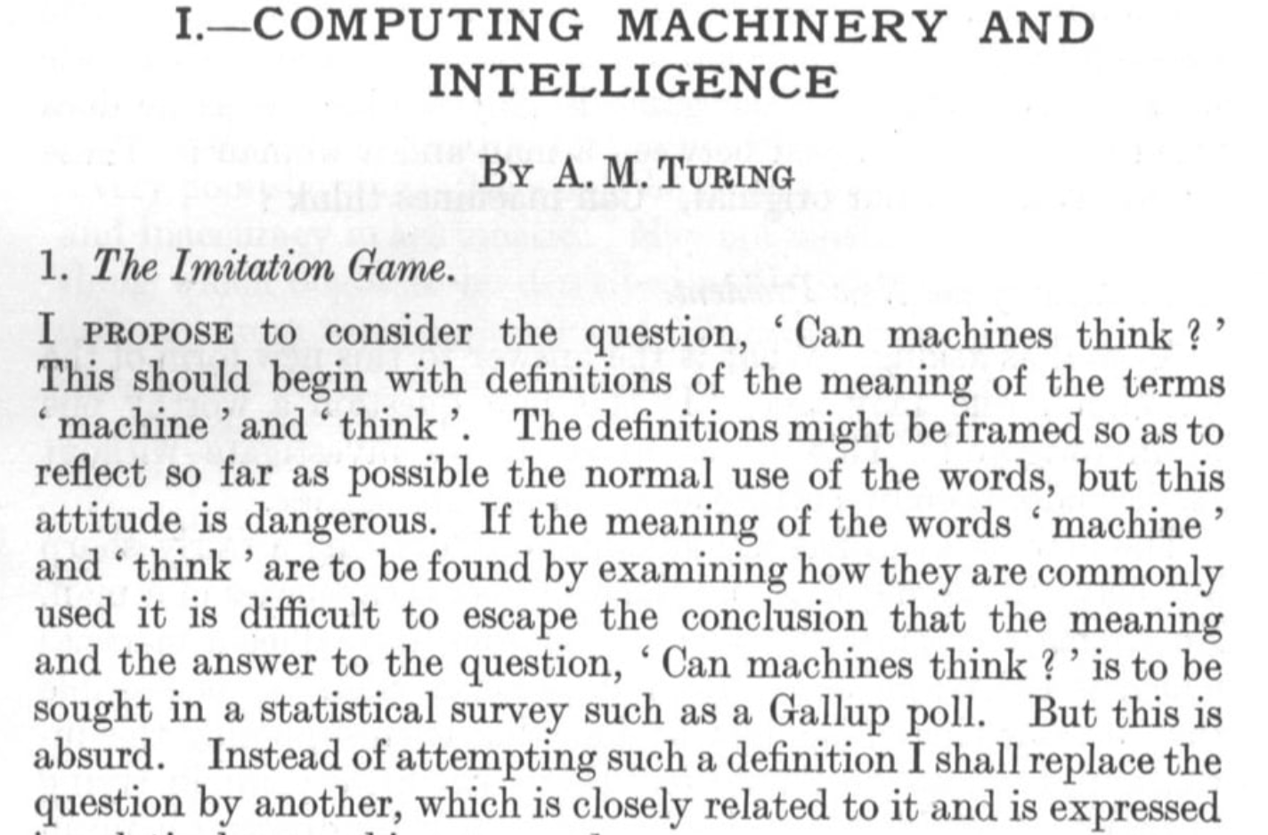
The History of AI - Alan Turing
Influential Paper ‘Computing Machinery and Intelligence’ 1950 asking fundamental questions about machine intelligence
‘Father of AI’

Slide 5
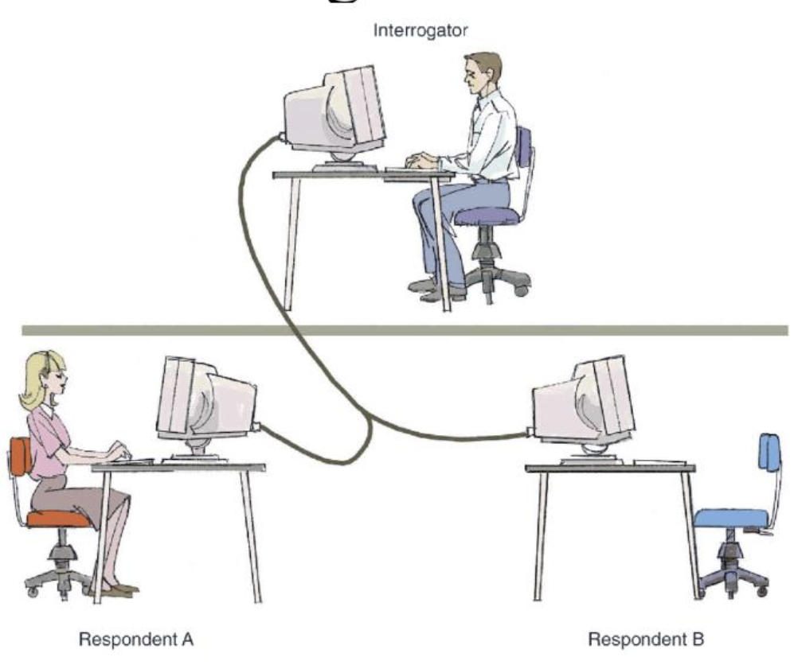
The History of AI - Turing Test
Turing Test:
‘Can a machine be linguistically indistinguishable from a human?’
Test Passed if judge can’t do better than correctly allocating 50/50 to machine/human

Slide 6
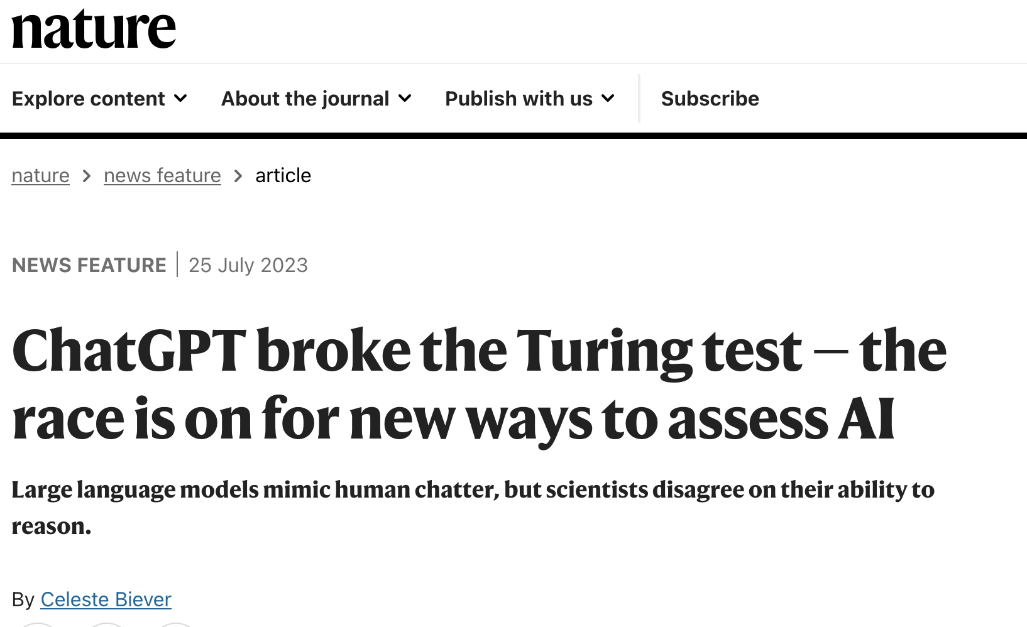
Turing Test
Turing himself predicted his test would be passed by 2000

Slide 7
Dartmouth Conference (1956): Birth of AI
Official start of the field of artificial intelligence (AI)
Famous attendees, sponsored by DARPA (Agency with the goal of creating breakthrough technologies for national security)
Achievements of the conference:
Term artificial intelligence was coined
Newell and Simon revealed the Logic Theorist Computer Program
First AI Program
Program proves mathematical Theorem
Conference found it to be a remarkable achievement

Slide 8
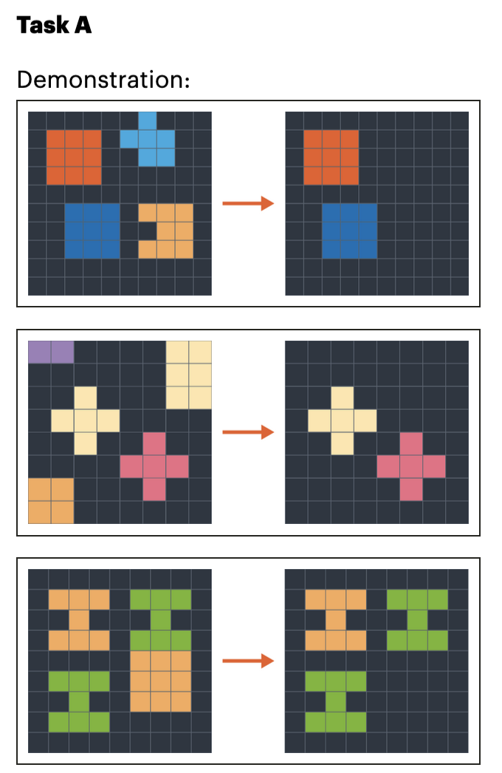
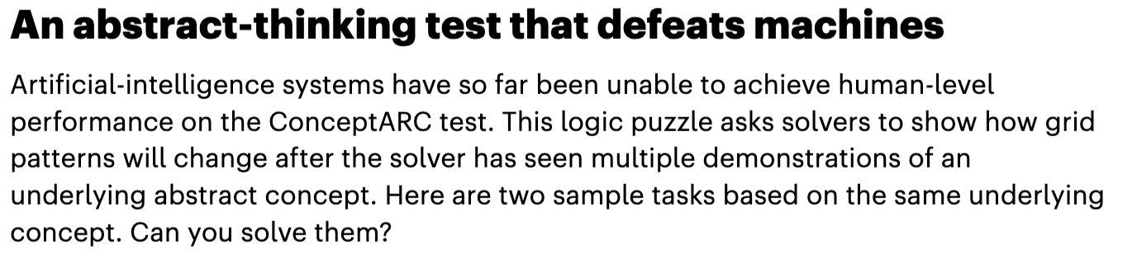
Conclusions of the Author
AI hasn’t managed to create general intelligence
Artificial general intelligence (AGI) matches or surpasses human cognitive capabilities across a wide range of cognitive tasks
Narrow AI matches human capabilities in a specific task

Slide 9
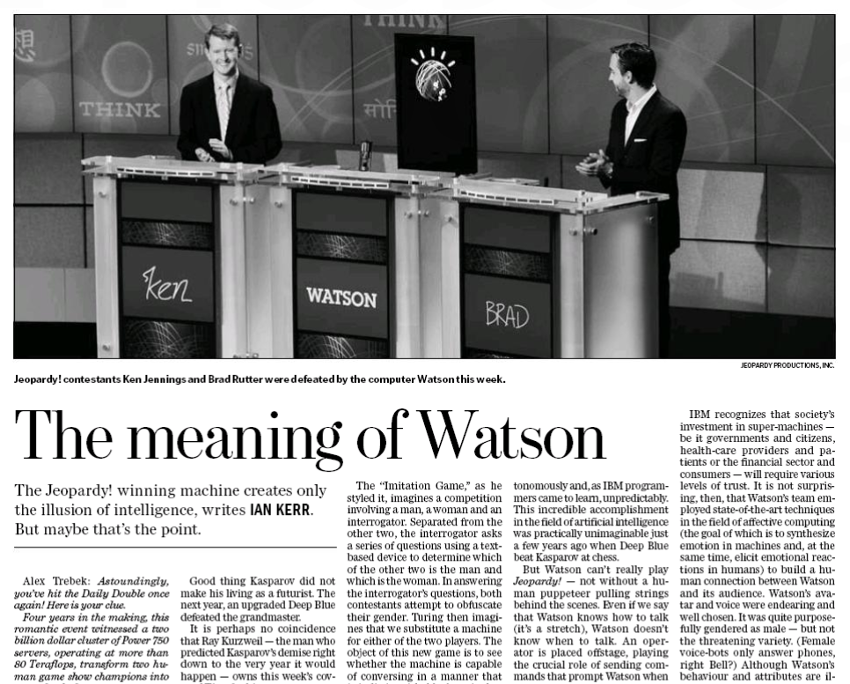
Group 1 - AI Milestones

Slide 10
IBM Watson & The Jeopardy! Challenge 2011
IBM supercomputer named after the first CEO competed against two of the most successful players
handled diverse question types across multiple domains
processes complex information and masters factual questions
limited by inability to handle dynamic questions or real-time conversation
considered more impressive than Deep Blue's chess victory
Groundbreaking Victory in Natural Language Processing

Slide 11
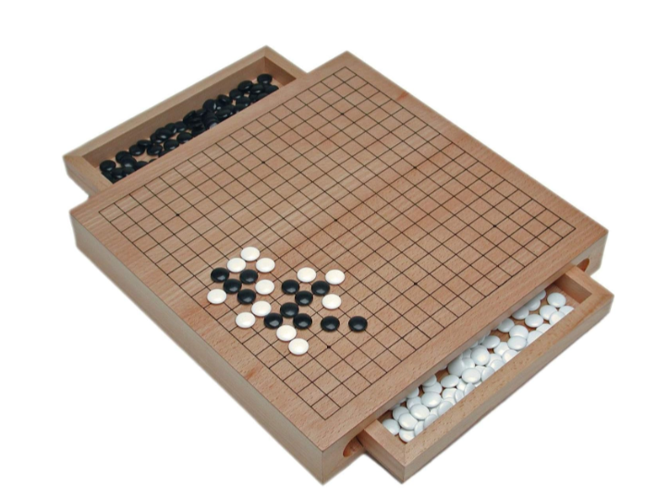
Google DeepMind's AlphaGo 2016
Defeated champion Lee Seedol in 4 out of 5 matches
higher complexity in Go compared to chess
however, while AlphaGo is a great Go player, it cannot understand a description of the rules in written English
Highlights distinction between specialized vs. general intelligence

Slide 12
Historical Roots
AI runs deep into the past, and has always had philosophy in its veins
both fields are concerned with understanding intelligence, reasoning, and the nature of thought
philosophy has provided the foundational ideas, questions, and frameworks that continue to shape AI
philosophers have shaped the theoretical foundations of probability and its interpretation
computer science emerged from logic and probability theory
Notes:
https://aima.cs.berkeley.edu/2nd-ed/cover.htm

Slide 13
Evolution of AI Thinking
Beyond Just Modern Computers
AI's development preceded digital computers
rooted in fundamental questions about reasoning and proof
early logicians proposed all thinking could be expressed in formal logic
contemporary AI combines ancient logical foundations with modern computational power

Slide 14
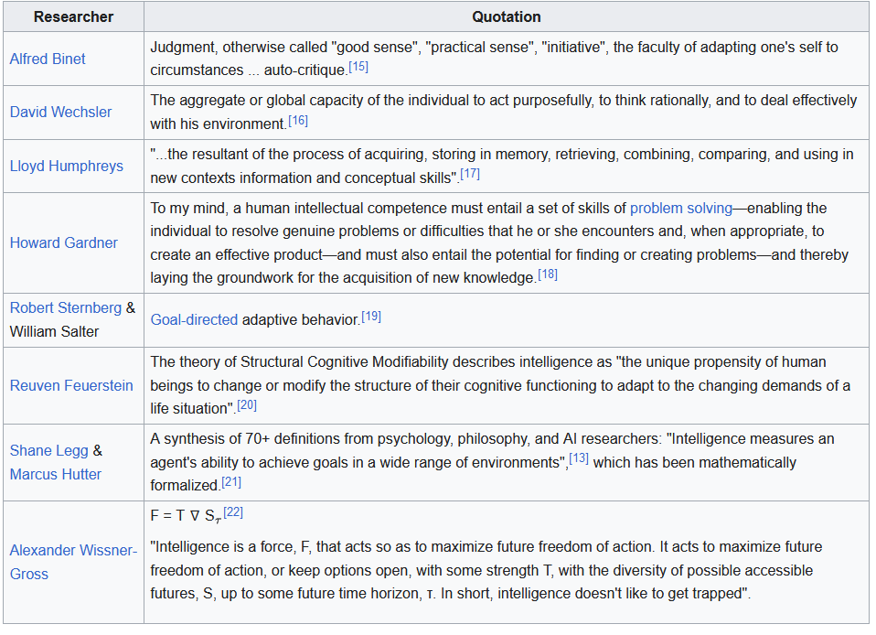
What exactly is AI?
AI lacks a universally accepted definition
Artificial: “Made or produced by people rather then occurring naturally”
Intelligence → Latin word intellegere: “the acquirement, processing and storage of information”

Slide 15
What exactly is AI?
Cambridge dictionary: “the use or study of computer systems or machines that have some of the qualities that the human brain has, such as the ability to interpret and produce language in a way that seems human, recognize or create images, solve problems, and learn from data supplied to them”

Slide 16
AI defined by goals
Russell and Norvig framework → AI: the Modern Approach (1995)
Two type of AI goals based on two dimensions:
1. Thinking vs. Acting
2. Human vs. Rational
The Four Categories:
Thinking like Humans: Replicating human thought processes.
Thinking Rationally: Logical reasoning and problem-solving.
Acting like Humans: Mimicking human behavior (e.g., Turing Test).
Acting Rationally: Intelligent agents that act based on rational principles.

Slide 17
Modern AI and the 4 categories
1. Systems That Think Like Humans
Examples: Chatbots, sentiment analysis, creative AI (art/music).
Movie: Her (2013)
2. Systems That Think Rationally
Examples: Expert systems, theorem provers, planning tools.
Movie: I, Robot (2004)
3. Systems That Act Like Humans
Examples: Humanoid robots, virtual assistants, gaming AI.
Movie: Ex Machina (2014)
4. Systems That Act Rationally
Examples: Self-driving cars, recommendation systems, trading bots.
Movie: The Matrix (1999)

Slide 18
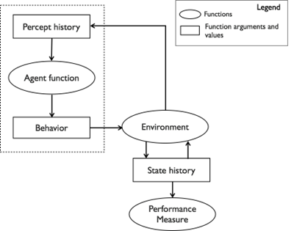
Conceptual model of intelligent agents
Russells work
Percept History → Agent Function → Behavior
Behavior → Environment → State History
State History → Performance Measure

Slide 19
Perfect rationality in AI
A perfectly rational agent is defined as one that maximizes expected utility (V) in its environment (E).
Limitation : Building a perfectly rational agent is often impractical due to computational limitations.
For example : writing an algorithm that guarantees an invincible chess strategy is infeasible because the number of possible game states is extremely large, making it impossible to evaluate all possibilities within a reasonable amount of time.
Instead, AI focuses on building calculatively rational agents

Slide 20
Calculative Rationality in AI
Aim for optimal solutions within a reasonable duration. If the program is executed infinitely fast, it would result in perfectly rational behavior.
Chess Example: calculatively rational agents search for good moves but limit their searches to ensure the game is played within reasonable timeframes. This means they find good (but not necessarily perfect) moves in limited time.

Slide 21
Russell’s Bounded Optimality
Machine Constraints: AI systems face limitations in computational power, memory, and processing capabilities. Efficient performance is particularly challenging on limited hardware, such as embedded systems or mobile devices, where both memory and processing power are restricted.
Russell’s Bounded Optimality: These agents are designed to be as optimal as possible within real-world machine and time constraints.

Slide 22
General Intelligence
Designing agents for general intelligence is currently beyond reach. Most AI systems are designed for specific tasks, not for general intelligence.
Example: In chess, the environment (E) is defined by the game’s rules and the board's state, whereas in Jeopardy!, E encompasses language comprehension and trivia knowledge across numerous domains. A generally intelligent agent would need a unified model capable of operating across all types of environments – an extremely challenging, currently unfeasible task.

Slide 23
Group 2 - Chapter 3

Slide 24
Group 2 - Chapter 3 - Approaches to AI (Nicolas)
3.1) The Intelligent Agent Continuum
3.2) Logic-Based AI
3.3) Non-Logicist AI
3.4) AI Beyond the Clash of Paradigms

Slide 25
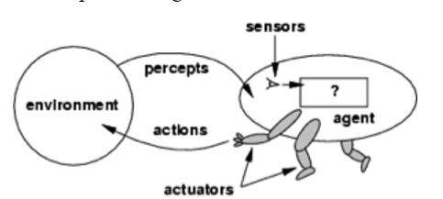
3.1) The intelligent Agent Continuum (Nicolas)
Concept: Agents represent functions mapping percept sequences to actions
Agent Evolution
Simple reflex: react to direct stimuli
Model-based: internal models to predict and act beyond immediate perception
Advanced: Incorporate reasoning, learning, and communication
Bringsjord, Selmer and Naveen Sundar Govindarajulu, "Artificial Intelligence", The Stanford Encyclopedia of Philosophy (Fall 2024 Edition), Edward N. Zalta & Uri Nodelman (eds.), URL = <https://plato.stanford.edu/archives/fall2024/entries/artificial-intelligence/>

Slide 26
3.1) The intelligent Agent Continuum (Nicolas)
Unsolved Challenges in AI
Learning by Reading:
Current models focus on function-based learning (e.g., mapping inputs to outputs).
Reading as a knowledge acquisition process remains a struggling challenge for AI compared to humans.
Example: Understanding "classroom" from pixels or actions like "HavingACupOfTea" requires high-level abstraction.
Consciousness and Creativity:
Subjective experiences and creativity are not addressed in mainstream AI research.

Slide 27
3.1) The intelligent Agent Continuum (Nicolas)
Philosophical and Practical Implications
Central Questions:
Can AI replicate the vast knowledge acquisition capabilities of humans (e.g., through reading)?
What about subjective consciousness and creativity?
Engineering Focus: AI emphasizes function over human-like processes (e.g., natural language understanding without full linguistic mastery).

Slide 28
3.1) The intelligent Agent Continuum (Nicolas)
Textbook Framework and Limitations
Common Themes:
Progression from simple to complex agents is a shared structure across AI textbooks.
Focuses on engineering intelligence rather than mirroring human cognition.
Gaps in Coverage
Phenomenal consciousness, creativity, and advanced abstraction largely ignored.

Slide 29
3.2) Logic-Based AI: Some Surgical Points (Nicolas)
Introduction to Reasoning in AI
Monotonic vs. Nonmonotonic Logic:
Monotonic logic: Adding new information doesn’t invalidate prior inferences.
Nonmonotonic logic: New information can invalidate previous inferences.
Example: Tweety is a bird → Tweety can fly; Tweety is a penguin → Tweety cannot fly.
Application: Captures real-world reasoning where beliefs can change.

Slide 30
3.2) Logic-Based AI: Some Surgical Points (Nicolas)
Logicist AI Framework
Concept: Use logical systems (e.g., first-order logic) to build intelligent agents.
Agent’s Life Cycle:
Sense: Perceives the environment.
Adjust: Updates the knowledge base using reasoning techniques.
Act: Performs actions based on goals.
Reasoning Modes: Deductive, inductive, abductive.

Slide 31
3.2) Logic-Based AI: Some Surgical Points (Nicolas)
Challenges and Future Directions
Scalability:
Reasoning speed needs to match real-world demands (e.g., robotics).
Broad Cognition:
Extending logical reasoning to tasks like motor control and perception.
Research Opportunities:
Advances in description logics for specialized domains (e.g., biomedicine).
Further development in encoding and hybrid reasoning systems.

Slide 32
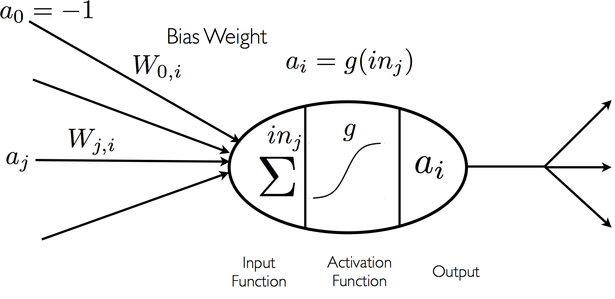
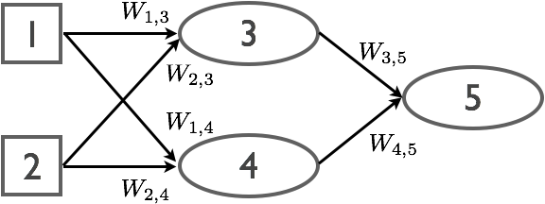
3.3) Non Logicist AI (Moataz)
Non-logicist AI is an approach that diverges from logicist AI by avoiding reliance on formal logical systems or declarative propositions to represent knowledge. Instead, it utilizes alternative formalisms that fall into two main categories:
Symbolic but Non-Logicist Approaches: These include methods like semantic networks, conceptual dependency schemes (Schank, 1972), and frame-based systems. These approaches organize knowledge in structured yet non-logical ways to improve readability and usability, but they lack the rigor of formal logic.
Neurocomputational Approaches: These rely on artificial neural networks (ANNs), which are inspired by biological neural systems. ANNs are composed of:
Nodes (neurons): Represent individual processing units.
Weighted connections (dendrites): Links between nodes, with each having a numeric weight.
Layers: Organized into input, hidden, and output layers, enabling hierarchical data processing.
Neural networks, while theoretically capable of universal computation, are primarily used for building learning systems. Their architecture allows them to learn from data by adjusting weights based on input, enabling them to recognize patterns and generalize across tasks. This flexibility makes ANNs particularly suited for tasks that cannot be easily structured using traditional logic.

Slide 33
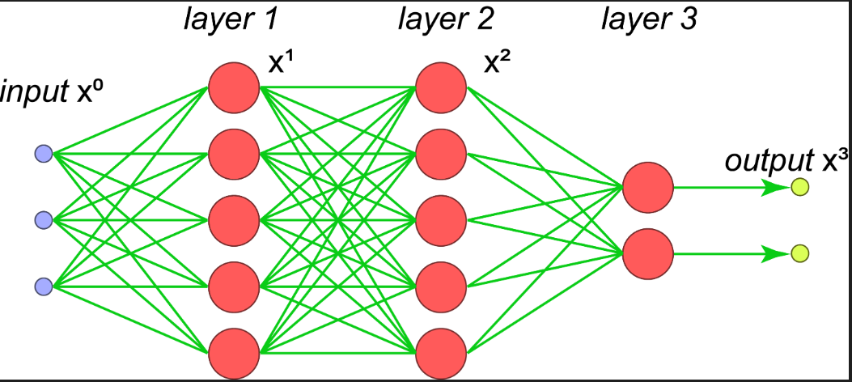
3.3) Non Logicist AI (Moataz)
Artificial Neural Networks (ANNs)
Structure and Components:
Neurons: Basic computational units that aggregate inputs and produce outputs based on an activation function.
Connections: Weighted links between neurons simulate synapses in the brain.
Layers: Include input, hidden, and output layers, with hidden layers enabling abstraction of data.
Computational Process:
Input Function: Aggregates inputs (sum of weighted activations).
Activation Function: Processes the aggregated input to determine the neuron's output.
Common activation functions:Step Function: and Sigmoid/Tanh Functions: Nonlinear outputs
Training:
Weights are updated iteratively using algorithms like backpropagation.
Networks learn from labeled data (supervised learning) or unlabeled data (unsupervised pre-training).
4. Early Challenges:
Training deep, multi-layered networks was computationally expensive and inefficient.
Limited to small-scale problems due to hardware constraints.

Slide 34
3.3) Non Logicist AI (Moataz)
Updated Summary: Non-Logicist AI with Today’s Technology
Non-logicist AI, propelled by deep learning and hybrid methods, now addresses challenges previously unattainable by early AI paradigms. It continues to redefine artificial intelligence, bridging the gap between data-driven adaptability and structured reasoning to solve real-world problems at scale.
Modern Innovations in Neural Networks:
Hardware Advances: GPUs and TPUs accelerated computations, enabling large-scale training.
Deep Learning: Architectures like convolutional neural networks (CNNs) for vision and transformers (e.g., GPT models) for language tasks enable state-of-the-art performance.
Pre-Training Techniques: Unsupervised pre-training allows layers to progressively learn from raw data (e.g., detecting edges, combining edges into features like eyes or faces).
Comparison with Early Non-Logicist AI
Early systems struggled with training inefficiencies and lacked scalability.
Today’s systems leverage distributed computing and optimized algorithms to handle massive datasets and complex tasks.
Neural networks now adapt dynamically, across tasks and domains, enabled by advances in transfer learning and multi-modal architectures.

Slide 35
3.3) Non Logicist AI (Moataz)
Updated Summary: Non-Logicist AI with Today’s Technology
Applications of Today’s Non-Logicist AI
Handwriting Recognition:
Benchmark problem solved effectively by neural networks trained on labeled datasets (e.g., MNIST database).
Image Recognition:
Layers process data hierarchically, enabling feature detection and object classification.
Natural Language Processing:
Neural networks underpin systems like translation tools and conversational AI. systems like ChatGPT handle tasks from summarization to creative writing.
Real-World Tasks:
Autonomous driving uses neural networks for vision, prediction, and decision-making.
Generative AI:
- Models generate new data—images, text, or music , Systems like DALL-E and ChatGPT exemplify the ability of neural networks to create realistic images and coherent text.
Hybrid Problem-Solving:
- Neurosymbolic systems integrate structured knowledge with adaptive learning for fraud detection and scientific discovery., Used in medical diagnosis, autonomous systems, and knowledge graph reasoning.

Slide 36
3.4) AI Beyond Clash Paradigms (Moataz)
Updated Summary: AI Beyond the Clash of Paradigms with Today’s Technology
Modern AI increasingly relies on hybrid systems that integrate logicist, probabilistic, and neurocomputational paradigms to address complex, real-world challenges. Today’s technology enhances these systems with unprecedented scale, speed, and adaptability.
Key Examples of Modern Hybrid Systems
IBM Watson and Advanced Q&A Systems:
Evolved versions integrate large language models (LLMs) like GPT-4 for deeper natural language understanding.
Combine symbolic reasoning with machine learning for applications in legal analysis, healthcare, and enterprise knowledge systems.
DeepMind’s AlphaZero and Generalized Game AI:
Successors to AlphaGo extend hybrid paradigms using reinforcement learning and neural networks, achieving superhuman performance in complex games like chess, Go, and StarCraft.
Combine planning algorithms with real-time learning for dynamic decision-making.
OpenAI’s GPT-4 and Codex:
Blend symbolic reasoning (code and structure) with neural models for language and programming tasks.
Enable real-time problem-solving, such as generating software code or assisting in scientific research.

Slide 37
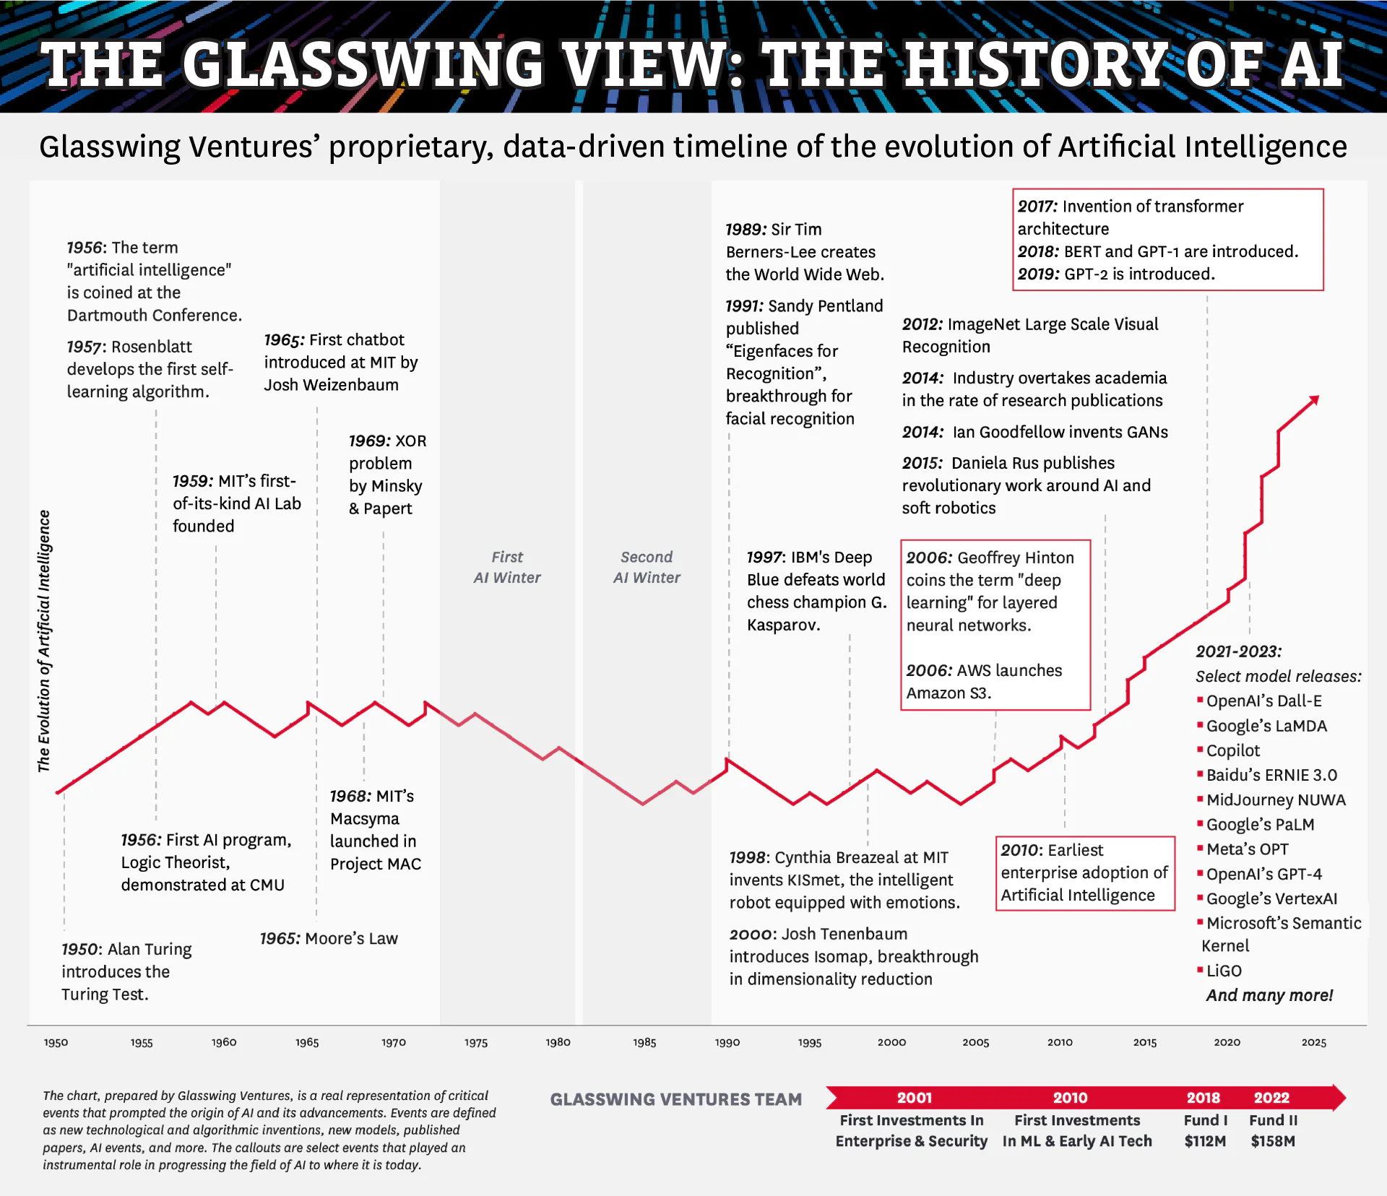
4 The Explosive Growth of AI
https://glasswing.vc/blog/thinking-corner/the-history-of-artificial-intelligence/

Slide 38
4.1 Bloom in ML
A huge part of AI’s growth is due to invention of new algorithms of machine learning (systems that improve performance based on examples or experience.).
Supervised Learning:
Learns a function using labeled data pairs.
Goal is to minimize error between the predicted function and true function.
Dominates ML applications, such as labeling images or detecting spam.
Unsupervised Learning:
Discovers patterns in raw data without labeled outputs.
Examples: Data mining and Google's PageRank algorithm.
Reinforcement Learning:
Machines learn through trial and error, using feedback (rewards/punishments).
Common in building game-playing agents (e.g., learning optimal chess moves).
https://glasswing.vc/blog/thinking-corner/the-history-of-artificial-intelligence/

Slide 39
4.1 Bloom in ML
Machine-learning algorithms are more and more used in all stages of the scientific process.
CERN’s particle accelerators: filter and analyze petabytes of data to identify meaningful events, such as Higgs Boson discoveries.
Genomics: analyze genomic sequences, predict gene structures, and identify genetic variants.
Astronomy: process images from telescopes to classify galaxies based on shape, size, and other features.
Big data: applying techniques derived from AI to large volumes of data
Explosion in data that does not have any explicit semantics attached to it and is not easily machine-processable (images, text, video (as opposed to carefully curated data in a knowledge- or data-base)).
https://glasswing.vc/blog/thinking-corner/the-history-of-artificial-intelligence/

Slide 40
4.2 - The Resurgence of Neurocomputational Techniques
Central dogma of AI: “What the brain does may be thought of at some level as a kind of computation”
Aspect | Symbolic AI | Connectionist AI
Inspiration | Logical reasoning | Brain's neural structure
Approach | Rule-based | Data-driven
Strengths | Interpretability, reasoning | Pattern recognition, adaptability
Limitations | Inflexible, hard to scale | Black-box nature, data-intensive
Applications | Knowledge bases, expert systems | Image recognition, speech processing
Both approaches are complementary, and modern AI often integrates symbolic reasoning with connectionist techniques for more robust and versatile solutions
https://glasswing.vc/blog/thinking-corner/the-history-of-artificial-intelligence/

Slide 41
4.2 - The Resurgence of Neurocomputational Techniques
Feature vector representation function is a transformation of the input into a format that filters out irrelevant information in the input and keep only information useful for the task
Feature Engineering: Previously, human experts manually crafted representations to transform raw data into useful inputs for learning, a labor-intensive process known as a "black art."
Deep Learning Breakthrough: Deep neural networks, with multiple hidden layers, automatically learn feature representations, reducing the need for manual engineering.
Example: Recognizing facial features while disregarding irrelevant factors like lighting.
https://glasswing.vc/blog/thinking-corner/the-history-of-artificial-intelligence/

Slide 42
4.2 - The Resurgence of Neurocomputational Techniques
Deep learning can safely be regarded as the study of models that either involve a greater amount of composition of learned functions or learned concepts than traditional machine learning does. (Bengio et al. 2015, Chapter 1)
Recent innovations have made deep learning more efficient and feasible, enabling its widespread application. State-of-the-art results in:
image recognition (given an image containing various objects, label the objects from a given set of labels)
speech recognition (from audio input, generate a textual representation)
the analysis of data from particle accelerators
https://glasswing.vc/blog/thinking-corner/the-history-of-artificial-intelligence/

Slide 43
4.2 - The Resurgence of Neurocomputational Techniques
Two significant challenges of deep learning:
Minor:
Still requires human expertise for architectural design and hyperparameter tuning. This process is often guided by intuition and experience, lacking systematic methodologies.
Major:
Vulnerability to Adversarial Inputs (intentionally altered data that appear normal to humans but cause neural networks to make incorrect predictions).
Can lead to high-confidence misclassifications, undermining the reliability of AI systems (a slight modification to an image can cause a model to misidentify objects).
The persistence of adversarial inputs across different models and datasets raises concerns about deploying AI in safety-critical applications
https://glasswing.vc/blog/thinking-corner/the-history-of-artificial-intelligence/

Slide 44
4.3 - The Resurgence of Probabilistic Techniques
2nd element to the explosive growth of AI: Non-neurocomputational probabilistic methods
AI uses a different than the standard approach stemming from a logic and technical philosophy
Random Variables: Fundamental proposition, allowing initial uncertainty for an agent
Notes:
The second dimension of the explosive growth of AI is the rise of probabilistic methods which do not rely on neurocomputational approaches to formalize a form of non-logical reasoning in the face of uncertainty.
Where traditionally AI is based on logic and technical philosophy, Eugene Charniak suggested and pushed a movement away from this logical based method towards a statistically driven one. Charniak boldly proclaimed, in a talk tellingly entitled “Why Natural Language Processing is Now Statistical Natural Language Processing,” that logicist AI is moribund, and that the statistical approach is the only promising game in town – for the next 50 years. Whether this is true or not is certainly up for discussion. The probabilistic and logic-based methods are not too dissimilar in their core as both are dealing with propositions which can be true or false in both theories. But where a key difference is that the probability driven approach uses the idea of Random Variables deeply rooted in probability theory to describe a case of uncertainty for an observer, whereas in a logistic approach the observer would need to know the answer before hand.

Slide 45
4.3 - The Resurgence of Probabilistic Techniques
The Kalmogorov Axioms apply and yet base the probabilistic approach in logic
Bayesian networks as a solution for the 2 problems: 1. Processing large quantities of data 2. Only propositional expressivity
One application of this model could be to ask for the probability of an hypothesis H_{x} being true
Notes:
The probabilities can be described in a boolean way. Using the example of the review, that Barolo commited the murder and is guilty, there is a probability attached to either the outcome of true and false.
However the random variables can also be discrete, as for example the distribution and thus probability of the tea prices in china which would range from 1 to 5 {1,2,3,4,5}. These probabilities can be joined together following the principles of probability theory and thus also the Kalmogorov Axioms apply.
(First axiom: Probabilities are real numbers that aren’t negative. A probability must be a real number that is not negative. The smallest probability of an event is zero, according to this principle. A probability theorem, on the other hand, does provide an upper bound.
Second axiom: At least one result in the sample space will occur with a probability of 1. This axiom states that viewing an experiment will result in a given outcome.
Third axiom: In a sample space with an unlimited number of disconnected events, the probability of the union of events is equal to the sum of all event probabilities. This postulate establishes a link between a collection of disconnected events in a sample space and their individual probability. A probability theorem demonstrates how a finite set of discontinuous events can also be expressed as an infinite set.)
Theorems of probability can then be derived using the axioms of probability.
Even with our simple example of guilty, weapon and tea prices, the number of atomic events already reached 20. This leads to on of two problems down the line, that these methods need to process incredible amounts of information.
And another problem which is more in the nature of the approach that like this it the expressivity is merely proprositional.
Bayesian networks are supposed to solve these two issues.
One practical application of this model is to ask for the probability of an hypothesis Hx being true. For example, one of the central classes of meta-theorems in learning, probably approximately correct (PAC) theorems, are cast in terms of lower bounds of the probability that the mismatch between the induced/learnt fL function and the true function fT being less than a certain amount, given that the learnt function fL works well for a certain number of cases

Slide 46
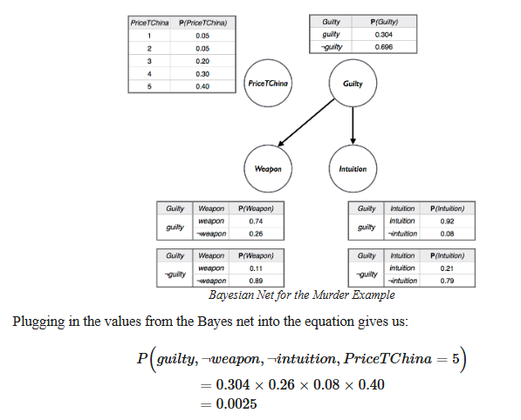

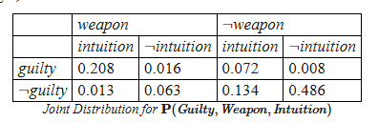


4.3 - The Resurgence of Probabilistic Techniques
Notes:
Based on the example of the Barolo mudrer case this is how a Bayesian network could look like.
There are three boolean variable guilty, intuition and weapon. The left-hand table explains their relationships. For this example they introduced the discrete variable of the tea prices in china as a discrete variable, raising the number of atomic events to 40 in this network.
Notice the economy of the network, in striking contrast to the prospect, visited above, of listing all 40 possibilities. The price of tea in China is presumed to have no connection to the murder, and hence the relevant node is isolated
Like this it is possible to calculate the possibility of a single atomic event or of course all of them and picking the one with the highest possibility.

Slide 47



Group 2 - Chapter 5 - AI in the Wild
Source: Absolutely AI (2023); Eldagsen (2023); GE Healthcare (2019); Passingham and Laughlin (2023); Sullivan (2023)
Notes:
Future of AI in the paper:
Web search, pattern recognition (fingerprint verification), computer games, mathematical proof
Since 2018 (when the paper was published) AI made enormous progress and we have new examples of AI in the wild. Specifically, AI has a great potential in various industries.
Health Care Industry: Diseases can be diagnosed easier or even identified – easier decision making,
Self Driving Cars: (in the paper they mentioned that such vehicles were in the testing phase) Today, Is able to maneuvre it themselves without a Human behind the Wheel, just with recognition of the environment and with multiple real-time analyses
Art: We can now generate images and create the most creative art works (Images: 2 AI generated images that won prizes at photo competitions and then revealed that they were generated by an AI)
Generative AI: Let’s us to easier translate text and supports us in generating text passages – let’s us «speak» to technology like to a human-being
There are a lot of things we can do with AI today and potentially in the future, but it is also important to recognize what are the limits?

Slide 48


Group 2 - Chapter 5 - Limits of AI
Notes:
Limits: AI is only performing for the task it is trained for (with the data it is trained)
For example: An AI tool that is trained to be very good at chess may master this task and is able to beat the bess human chess player in the world…
… But if you set it in front of a Monopoly board and want it to play Monopoly, ...it fails miserably.

Slide 49
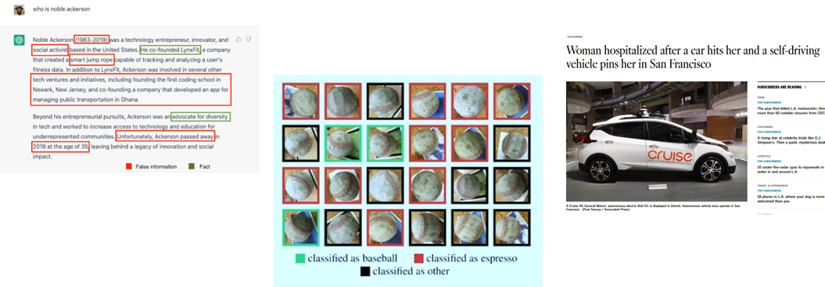
Group 2 - Chapter 5 - Limits of AI
Source: Ackerson (2023); Betzendahl (2021); Sancya (2023)
Notes:
But also for the tasks at the AI is trained for, (it may perform good,) but it is never correct in 100% of the cases.
Self-driving cars: When we look at the example of the self-driving cars, there is the possibility, that one of the surroundings gets categorized wrongly which in one instance led to a woman being hospitalized, because a self-driving car didnt recognize her as a human. As a consequence, the autonomous self-driving cars are not operating anymore in San Francisco.
ChatGPT: It can be a good assistance, but (da es «lediglich» schaut, welches mit grösser wahrscheinlichkeit das nächste wort in der wortfolge/kette sein kann) it also hallucinates aussagen. Here we see, how much false information was in an output generated by ChatGPT.
Third we have an image recognition system: The system was trained to recognize baseballs, but it often failed and saw an espresso in the image. Here the wrong classification does not harm anyone, but imagine a image classification system that aims to detect tumors in radiology images. A wrong classification there can have crucial consequences for the health of the patient.
But also when an AI tool does perform well, it can have negative implications.

Slide 50

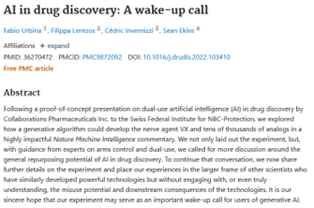

Group 2 - Chapter 5 - Dark Side of AI
Dual use problem
Source: art_is_2_inspire (2023); Urbina et al. (2022)
Notes:
Then we speak of the so-called dual use problem.
Dual use problem: Inventions can be used for a negative purpose
(AI to generate images/art can be beneficial and be used to create beautiful artwork, but it can also be used to generate False Information at a massive scale and spread fake information, e.g. the popular generated image of the pope)
Case where researchers worked with an AI algorithm that developed blueprints of molecules that then were used to develop drugs to help patients, they tested a thing with the algorithm. -> 0 zu 1 geändert, dass es möglichst toxische molekül-blueprints erstellen soll -> am nächsten Tag hatten sie 10’000 baupläne für nervengifte, die zu den deadliest of the welt zählen.
So we can see that AI has huge potential and can do a lot of good in the world. But it also has its limitations, which is why it is very important that we treat AI responsibly and always take a critical and reflective view of it. This concludes our presentation of chapters 3 to 5.

Slide 51
Chapter 6: Moral AI
Notes:
Vorstellung Sukanya und Sigve, Umfrage

Slide 52
Introduction to Moral AI
Computer Ethics vs. Robot Ethics
Computer Ethics focus on human behaviour in tech contexts
How do we humans behave when we use computers/internet/AI
Robot ethics (Moral AI, machine ethics): Focus on autonomous machines making moral decisions.
morality of machine itself: Machine makes a decision with moral weight and choosing between live and death
Challenges in Moral AI
Robots making ethically significant decisions (e.g., lethal actions).
The need for ethical reasoning in robots with decision-making power.
Challenges for developing a system that ensures the robot acts ethically by its own decision. (no human interaction)

Slide 53
Approaches to Building Moral Machines
Ethical AI Spectrum
Includes both lethal and non-lethal situations (e.g., lying machines).
also ethically questionable actions (Trust, Honesty, Social impact of robots)
Framework for Moral Machines
Machines need a moral code to guide decision-making.
to align with human moral standards
Moral code can be input directly or inferred from basic laws.
Challenge:
Make the Robot understand and follow the moral code in unpredictable situations

Slide 54
Deontic Logics in Moral AI
Deontic Logic for Ethical Reasoning
Formal logic concerned with moral codes (obligations, permissions, prohibitions).
what actions are required, allowed, forbidden according to Moral Code
Used to ensure robots follow a moral code in all circumstances.
MUST not harm human being, but MAY CHOOSE to help someone
Formal-Logic Verification
Robots’ actions can be verified before real-world deployment using deontic logic.
Ensures robots behave ethically in infinite scenarios. (as many scenarios as you are able to test)

Slide 55
The Future of Moral AI
Early Work in Ethical Machines
Example: Pereira and Saptawijaya's work on contractualism.
Moral Theory states: actions are right if they are justifiable to others based on social contract.
Growing Importance of Robot Ethics
As robots gain autonomy, ethical considerations will increase in importance.
Ethical standards for robots may differ from those applied to humans.

Slide 56
Chapter 7: Philosophical AI
Notes:
Vorstellung Sukanya und Sigve, Umfrage

Slide 57
Introduction to Philosophical AI
• What is Philosophical AI?
Philosophical AI applies ideas and methods from philosophy to AI development. It’s not about debating AI’s impact or ethics (that’s Philosophy of AI), but about solving philosophical problems in ways that can be implemented in AI systems.
• Key Feature: Philosophical reasoning leads to technical implementations. For example, solving a paradox through logic and creating a program that can handle such paradoxes in practice.
• Distinction:
Philosophy of AI: Explores the implications of AI (e.g., can machines think? Is AI ethical?).
Philosophical AI: Focuses on using philosophy to shape AI systems.
Notes:
Vorstellung Sukanya und Sigve, Umfrage

Slide 58
Daniel Dennett’s View on AI and Philosophy
• Who is Daniel Dennett?
A philosopher known for exploring consciousness, cognition, and the relationship between AI and philosophy.
• His Claim: AI is philosophy in action, particularly cognitive psychology, as it seeks to answer the question:
• How is knowledge possible?
Top-Down Approach: AI should not just mimic biological systems (like neural networks do) but instead design abstract algorithms that replicate high-level cognitive processes. Top-Down means starting with abstract, overarching principles and applying them, rather than building from smaller, simpler components.
Notes:
Vorstellung Sukanya und Sigve, Umfrage

Slide 59
Critique of Dennett’s View
• Objection to Dennett’s Claim:
Critics argue that by focusing only on computational mechanisms, AI limits itself to a specific type of intelligence.
• Mechanistic Limitations:
• AI assumes intelligence can be reduced to mechanisms (like algorithms and computations).
• This excludes broader perspectives, like those from vitalists (who believe life involves more than physical processes) or dualists (who see the mind as separate from the body).
• Dennett’s Defense:
• AI’s mechanistic approach aligns with psychology and relies on Church’s Thesis.
Notes:
Vorstellung Sukanya und Sigve, Umfrage

Slide 60
What is Church’s Thesis?
Church’s Thesis (also known as the Church-Turing Thesis) is a foundational concept in the theory of computation. It is named after mathematicians Alonzo Church and Alan Turing, who independently proposed it in the 1930s. The thesis makes a claim about the nature of computability, specifically the kinds of functions that can be computed.
Church’s Thesis Explained:
Church’s Thesis asserts that a function is effectively calculable (or computable) if and only if it can be computed by a Turing machine. In other words, if a problem can be solved by an algorithm or mechanical procedure, it can be solved by a Turing machine.
Key Concepts:
1. Turing Machine:
A theoretical machine introduced by Alan Turing in 1936 that manipulates symbols on an infinite tape according to a set of rules. Turing machines are used to model what it means to compute a function or solve a problem. The power of a Turing machine lies in its simplicity and ability to simulate any computation that can be done by any other mechanical or algorithmic process.
2. Effective Computability:
A function or problem is considered effectively computable if it can be solved by an algorithm that can be executed step-by-step by a human or machine. This type of computation corresponds to the idea of solving a problem with a clear, finite procedure.
3. Computability and Functions:
Church’s Thesis suggests that any function that can be computed by a well-defined algorithm or mechanical process can be computed by a Turing machine. In other words, the set of computable functions is the same as the set of functions that can be computed by a Turing machine.
Notes:
Vorstellung Sukanya und Sigve, Umfrage

Slide 61
The Scope of AI vs. Philosophy
• Philosophy’s Breadth:
Philosophy and psychology explore intelligence broadly, including non-mechanistic or non-computational aspects.
• AI’s Narrow Focus:
AI is about creating computational artifacts (programs, systems) to model or replicate intelligence.
• Risk of Misidentification:
• Calling AI “philosophy” might confine philosophy to computational perspectives, ignoring broader insights.
Notes:
Vorstellung Sukanya und Sigve, Umfrage

Slide 62
AI’s Practical Goals vs. Abstract Philosophy
• AI’s Main Goal:
Build systems that are useful, efficient, and profitable.
Examples: Recommendation systems, chatbots, self-driving cars.
• Philosophical AI’s Goal:
Integrate philosophical principles into AI to solve abstract or conceptual problems.
Example: Programming a system to handle ethical dilemmas using philosophical reasoning.
Case Study: The OSCAR Project, which merges philosophy and AI.
Notes:
Vorstellung Sukanya und Sigve, Umfrage

Slide 63
John Pollock’s OSCAR Project
• What is OSCAR?
A reasoning system developed by philosopher John Pollock. It addresses problems like decision-making and reasoning using both philosophical principles and AI techniques.
• Why Important?
Shows how philosophy can directly inform AI development.
Published in leading AI journals, proving its technical and practical relevance.
Takeaway: Philosophical thinking can enhance AI by providing deeper and conceptual frameworks for solving problems.
Notes:
Vorstellung Sukanya und Sigve, Umfrage

Slide 64
Broader Connections Between AI and Philosophy
1. Epistemic Logic: A branch of philosophy exploring knowledge and belief; applied in AI for reasoning systems.
2. Inductive Learning: Philosophical studies on how we learn new ideas help improve AI methods like Inductive Logic Programming, which creates rules based on data.
Notes:
Vorstellung Sukanya und Sigve, Umfrage

Slide 65
Philosophical Nature of AI Textbooks
• Textbooks like AIMA (Artificial Intelligence: A Modern Approach) discuss the philosophical underpinnings of AI.
• They explore questions like: What is intelligence? How can it be built?
• Integration of Philosophy: AI education incorporates philosophical questions to guide technical approaches.
Notes:
Vorstellung Sukanya und Sigve, Umfrage

Slide 66
Conclusion
• Philosophical AI: A powerful blend of philosophy and technical engineering that enhances AI’s capabilities and depth.
• Distinction: AI is not philosophy, but philosophical concepts are integral to AI’s development.
• Future Directions: Continuing to explore the philosophical dimensions of intelligence will broaden AI’s scope and potential applications.
Notes:
Vorstellung Sukanya und Sigve, Umfrage

Slide 67
Chapter 8.1 Strong vs. Weak AI
Weak AI
Goal: Build machines that simulate human behavior and pass the Total Turing Test (TTT):
Beyond linguistic indistinguishability.
Mimics also other human behaviors
Weak AI is generally seen as feasible achieve
Strong AI
Goal: Create artificial persons with human-like mental powers, including consciousness.
Machines would truly think, feel, and possess consciousness, similar to humans.
Strong AI strives for true human-like intelligence but faces philosophical skepticism.
Heavily debated; critics (e.g., Searle) challenge whether machines can truly think or feel.
Notes:
Then we speak of the so-called dual use problem.
Dual use problem: Inventions can be used for a negative purpose
(AI to generate images/art can be beneficial and be used to create beautiful artwork, but it can also be used to generate False Information at a massive scale and spread fake information, e.g. the popular generated image of the pope)
Case where researchers worked with an AI algorithm that developed blueprints of molecules that then were used to develop drugs to help patients, they tested a thing with the algorithm. -> 0 zu 1 geändert, dass es möglichst toxische molekül-blueprints erstellen soll -> am nächsten Tag hatten sie 10’000 baupläne für nervengifte, die zu den deadliest of the welt zählen.
So we can see that AI has huge potential and can do a lot of good in the world. But it also has its limitations, which is why it is very important that we treat AI responsibly and always take a critical and reflective view of it. This concludes our presentation of chapters 3 to 5.

Slide 68
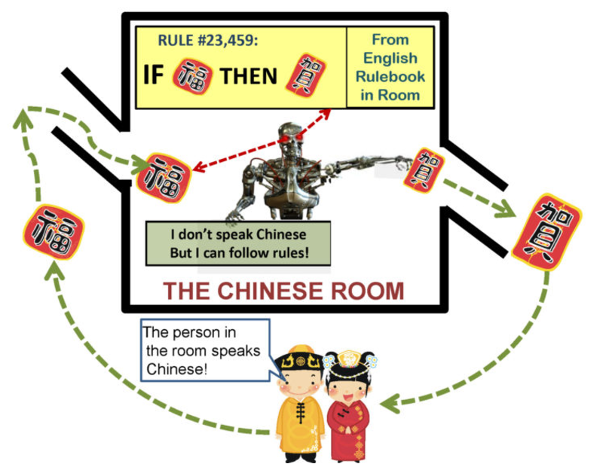
Chapter 8.2 The Chinese Room Argument
Thought Experiment Introduced by John Searle (1980) to challenge "Strong AI."
Searle is in a room with a rulebook for Chinese.
Native Chinese speakers pass questions (input) written in Chinese into the room.
Searle uses the rulebook to generate answers (output) in Chinese.
Searle manipulates symbols without understanding Chinese.
Conclusion: Computers, like Searle in the room, process information syntactically without true semantic understanding.
Machines can simulate thought but cannot possess genuine understanding or consciousness.
https://www.learningmachines101.com/lm101-006-interpret-turing-test-results/
Notes:
Then we speak of the so-called dual use problem.
Dual use problem: Inventions can be used for a negative purpose
(AI to generate images/art can be beneficial and be used to create beautiful artwork, but it can also be used to generate False Information at a massive scale and spread fake information, e.g. the popular generated image of the pope)
Case where researchers worked with an AI algorithm that developed blueprints of molecules that then were used to develop drugs to help patients, they tested a thing with the algorithm. -> 0 zu 1 geändert, dass es möglichst toxische molekül-blueprints erstellen soll -> am nächsten Tag hatten sie 10’000 baupläne für nervengifte, die zu den deadliest of the welt zählen.
So we can see that AI has huge potential and can do a lot of good in the world. But it also has its limitations, which is why it is very important that we treat AI responsibly and always take a critical and reflective view of it. This concludes our presentation of chapters 3 to 5.

Slide 69
Chapter 8.2 The Chinese Room Argument
Criticism from AI Researchers:
Many AI experts dismiss CRA, calling it unrealistic or irrelevant to real-world AI development.
Focus is on building machines that act intelligent, not on proving they "understand."
Searle’s Response:
Even advanced AI systems only simulate understanding.
He argues they manipulate symbols without real meaning or consciousness.
Why CRA Still Matters:
Sparks debates on whether machines can truly think or just mimic thought.
Raises concerns about future AI, including ethical issues and risks.
Relevant for guiding AI research and policymaking.
Notes:
Then we speak of the so-called dual use problem.
Dual use problem: Inventions can be used for a negative purpose
(AI to generate images/art can be beneficial and be used to create beautiful artwork, but it can also be used to generate False Information at a massive scale and spread fake information, e.g. the popular generated image of the pope)
Case where researchers worked with an AI algorithm that developed blueprints of molecules that then were used to develop drugs to help patients, they tested a thing with the algorithm. -> 0 zu 1 geändert, dass es möglichst toxische molekül-blueprints erstellen soll -> am nächsten Tag hatten sie 10’000 baupläne für nervengifte, die zu den deadliest of the welt zählen.
So we can see that AI has huge potential and can do a lot of good in the world. But it also has its limitations, which is why it is very important that we treat AI responsibly and always take a critical and reflective view of it. This concludes our presentation of chapters 3 to 5.

Slide 70
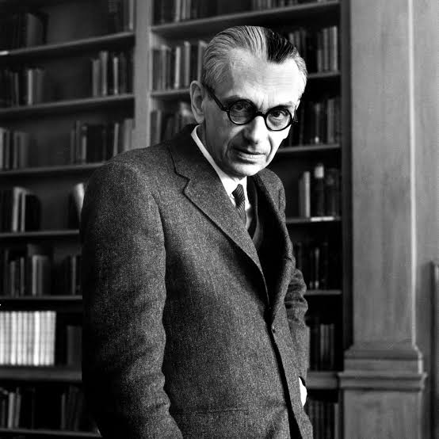
Chapter 8.3 The Gödelian argument
2nd argument against “strong” AI (= machines with all human mental powers)
J.R. Lucas (1964):
No machine can ever reach human-level intelligence according Gödel’s first incompleteness theorem.
Gödel (1906-1978; a logician, mathematician and philosopher)
Any consistent and powerful enough set of axioms and rules cannot prove or disprove the statements that can be written down using symbols:
some statements are true but unprovable
some statements are false but undecidable
Source: The New Yorker, 2021; https://www.newyorker.com/

Slide 71
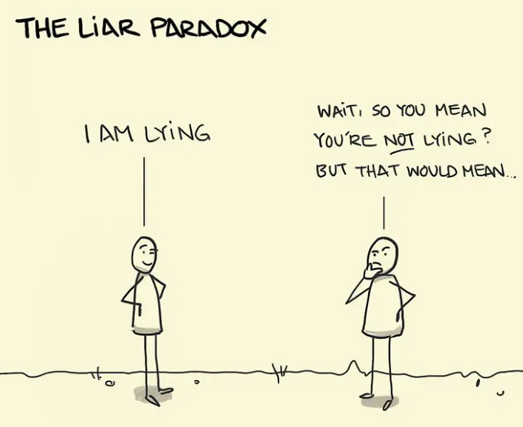
Chapter 8.3 The Gödelian argument
Consistent set of axioms and rules ≠ contradiction
Contradiction: a statement that is both true and false at the same time
“This statement is false”:
if it is true, then it is false
if if it is false, then it is true
Source: https://sketchplanations.com/
“This statement cannot be proved using the axioms and rules” (contradiction)
Gödel’s Incompleteness Theorems for Dummies! | by Almas K. | Medium

Slide 72
Chapter 8.3 The Gödelian argument
Gödel’s theorem means: no matter how powerful and AI system is, there will always be some truths that it cannot know
AI systems can never be truly perfect or infallible (capable of making mistakes)
AI systems will always need to be updated with new information
There are things AI systems can never understand
Limitations of Gödel’s theorems: they only apply to:
formal axiomatic systems (do not apply to all kinds of knowledge; e.g. acquired through experience or intuition)
systems that are consistent
systems that are capable of modelling basic arithmetic (do not apply to more complex models; e.g. systems that can model the real world)
Gödel’s Incompleteness Theorem and the Limits of AI | by Matt Fleetwood | Medium

Slide 73
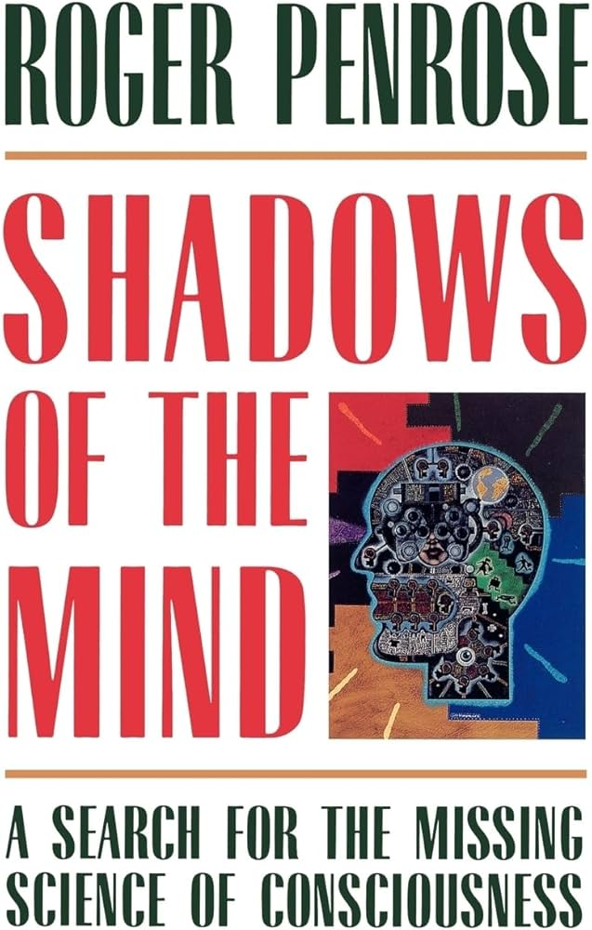
Chapter 8.3 The Gödelian argument
J.R. Lucas (1964): “No machine can ever reach human-level intelligence according Gödel’s first incompleteness theorem”. Although it has not proved to be compelling, initiated a debate.
Roger Penrose (physicist) defender of the argument:
The Emperor’s New Mind (1989)
Shadows of the Mind (1994)
The four fundamental positions on AI (extracted from Bringsjord and Xiao, 2000)
All thinking is computation (feelings of conscious awareness evoked by appropriate computations)
Awareness is a feature of the brain physical action
Appropriate physical action of the brain evokes awareness (cannot be properly simulated computationally)
Awareness cannot be explained by physical, computatiational, or any other scientific terms

Slide 74
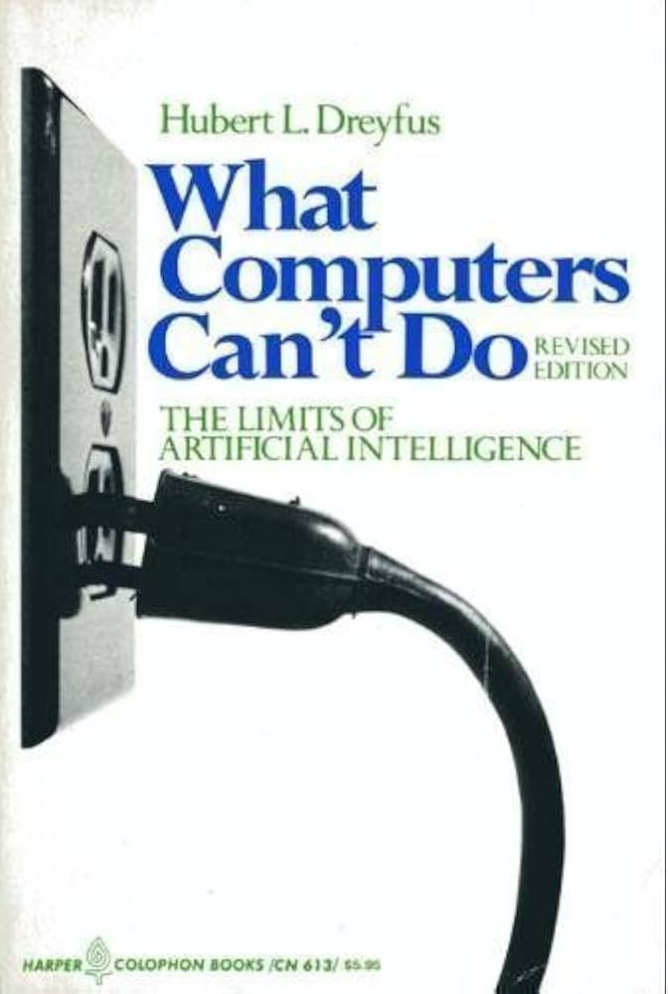
Chapter 8.4 Additional topics and readings
3rd attack to “strong” AI: the Dreyfusian attack (Dreyfus)
“Human expertise is not based on the explicit, disembodied, mechanical manipulation of symbolic information”
Intelligence cannot be reduced to following rules
Context is critical to facilitating learning (environment “shows up” for an individual as one progresses through their learning curve: novice vs. expert)
Mind and body work together to cultivate learning and intelligence
A living body has interests and needs (nothing is neutral in the act of learning and mastering skills)
To replicate intelligence with AI, we need:
replicating intelligence and consciousness
programming:
the way things show up for us
a model of our bodies
our distinctive values and motivations
Fjelland, 2020. Why general artificial intelligence will not be realized ? Humanities & Social Sciences Communications, 7:10. https://doi.org/10.1057/s41599-020-0494-4

